Slide 1
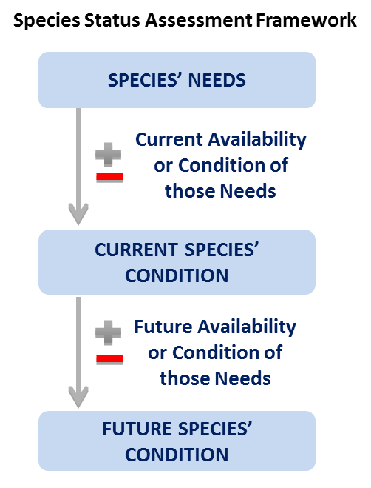
Current Condition
Notes:
This afternoon we will focus our time on the second part of the SSA Analytical Process – the Current Condition. This part of the SSA describes the “current condition” of the species’ habitat and demographics, and the explanations for past and ongoing changes in abundance and distribution within areas representing important geographic, genetic, or life history variation.
This is an empirical assessment based upon available data and knowledge. Where do you think most of the information for current condition comes from? (primarily from agencies, but also…graduate research, etc…) Refer back to that list (posted) from Monday afternoon.

Slide 2
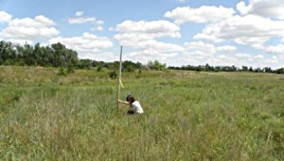
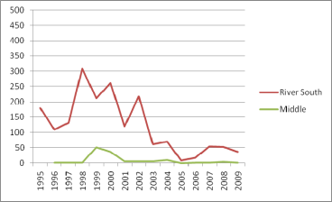
Current Condition
Habitat
Species
Quality
Quantity
Connectivity
Population size
Growth rate
Number of pops
Distribution of pops
Notes:
What is the habitat for our species like right now, and how did it get this way?
In the Current Condition section of our SSA, we need to document the quality (click), quantity (click), and connectivity(click) of habitat available for survival and reproduction of individuals to support population resilience.
We also need to document the current population sizes (click), growth rates (click), and the number (click) and distribution (click) of the populations within the species’ ecological settings.

Slide 3
Current Condition
NEEDS
Habitat
Demographics
Population
Resilience
Species
Viability
WHY: CAUSE/EFFECTS
HAS:CURRENT CONDITIONS
Anthropogenic and Environmental Factors (+ & -)
Habitat
Demographics
Population
Species
Notes:
So as we evaluate the current condition, we do it in the context of what it needs [click] – are all the components of the ecological system present and functioning properly? Where do we have key components missing or reduced? What do we know and what do we not know? Ultimately we want to know the condition at the rangewide, species level, but to do that we will need to understand the condition of the habitat and the individuals to get to the status of populations.
[click]
So now we need to explore why the species does not have what it needs. The anthropogenic and environmental factors (both positive and negative) that act either [click] directly on individuals or indirectly through its habitat. Ah – Ha , here are your threats. But they are in the context of explaining the current condition. What has happened in the past that resulted in our current condition?
Let’s expand that...

Slide 4
Current Condition
Future
Condition
Current Condition
GOAL
SPECIES METRIC
PRESENT
T I M E
Notes:
One way to approach this is to start with a description of existing data. The data is influenced by fluctuations in species status and sampling error and random noise
[click] The brown arrow indicates the average species status to the present day
This graph sets up Future Condition, which will be the topic of the next day.

Slide 5
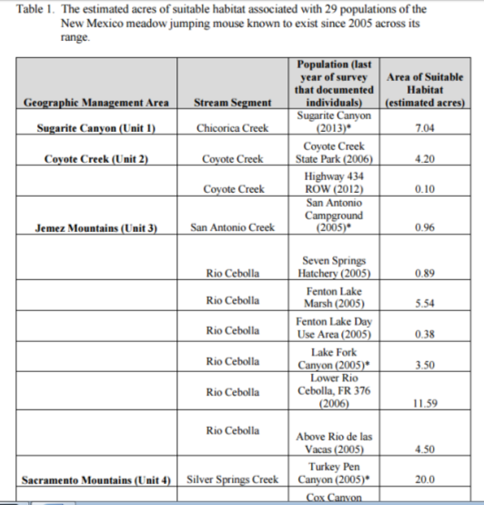
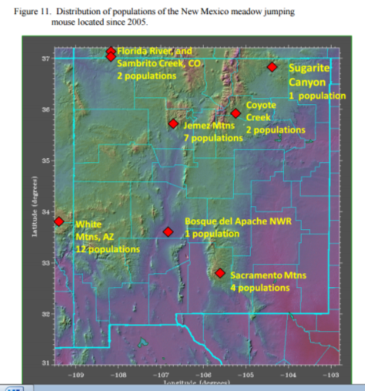
Current Condition
Notes:
Here are some examples for you to consider. The New Mexico Jumping Mouse SSA looked at these populations…
(click) …and then estimated the acres of suitable habitat within each in a Table, like this.

Slide 6
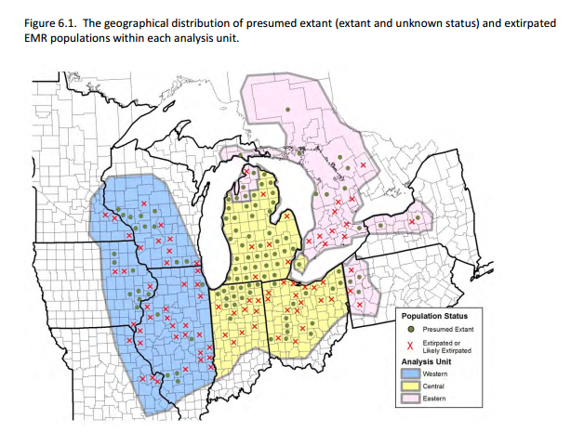
Current Condition
Notes:
The Eastern Massasauga Rattlesnake SSA mapped out presumed extant and extirpated populations.

Slide 7
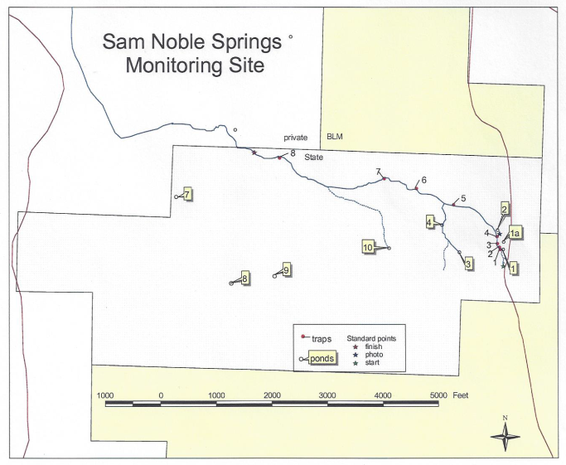
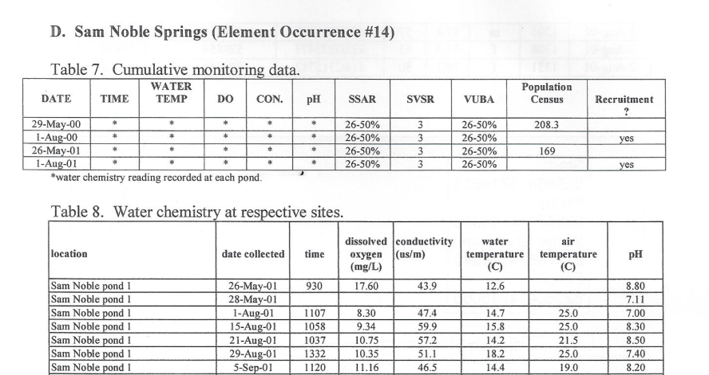
Current Condition
Notes:
Or, maybe you are lucky to have populations that have a standardized monitoring protocol in place, [click] where you obtain baseline information on a regular basis for both important habitat qualities and species numbers.
(This example is from the Columbia spotted frog monitoring plan, in 2000 and 2001)

Slide 8
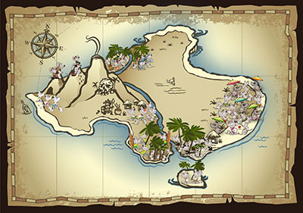
Current Condition
EXERCISE 5.
Current Condition
Notes:
In this Exercise, you will identify the trend and current condition of your population and then complete the Table of your population’s current condition (similar to the Table you created earlier for what your population needs). Transcribe the information from your workbooks onto the cards provided and post on the wall map under your Population Needs Table (at the end of this exercise, there should be three cards at each population on the map – needs, trend, and current condition).
Select a speaker for your population to report out on the trend and current condition. (Is there a big difference between what it NEEDS and what it HAS?)

